Slide 1
Social Determinants: Implications for Service Delivery
Presenters NAME, TITLE
DATE

Slide 2
Introductions
Introduce yourself – name, role, agency
What is one thing that you would like to get as a result of participating in this discussion session?

Slide 3
Objectives
At the end of this discussion session participants will be able to:
Define what are the social determinants of health, health disparities and health equity
Give examples of the impact of social determinants on the populations served
Define strategies to improve social determinants for individuals representing racially, ethnically and culturally diverse populations.

Slide 4
Social Determinants of Health
Life-enhancing resources
Food supply
Housing
Economic stability/employment
Social relationships
Education
Health care
Transportation
Effectively determine length and quality of life.
Are responsible for most national and global health disparities and inequities
Source: https://www.cdc.gov/socialdeterminants/index.htm
Notes:
-Social Determinants of Health: are the physical, emotional, and social factors that surround our lives that help us maintain good physical, psychological, and social health.
-They include adequate supply of food and good nutrition; safe and affordable housing; employment in jobs that sustain us and provide adequate economic resources to live on; social connectedness with supportive people, family and friends; good quality education and educational opportunities; access and availability of affordable quality healthcare; and adequate transportation to be able to take care of our daily needs.
-Social determinants of health maintain and sustain us. When they are missing, of poor quality, or in short supply we become less healthy.
-Many times the distribution of social determinants of health affect groups positively or negatively leading to health and other disparities and ultimately they determine the length and quality of our lives.
Discussion: Can you give an example when one or more of these life enhancing resources has led to poorer health among your students and their families?
What groups do you think are more negatively affected? Do you see examples in your classroom?

Slide 5
Group Discussion
Can you give an example when one or more of these life enhancing resources has led to positive or negative outcomes for the children, youth and families and you serve?
What groups do you think are more negatively impacted?
What examples do you see in your own work?

Slide 6
Health Disparities
Differences in the incidence and prevalence of health conditions and health status between groups, such as diabetes or heart disease.
Most health disparities affect groups marginalized because of socioeconomic status, race/ethnicity, sexual orientation, gender, disability status, geographic location, or some combination of these.
Health disparities are also referred to as health inequities when they are the result of the systematic and unjust distribution of these critical conditions.
Notes:
-It is projected that individuals from racial/ethnic groups will become the majority of the U.S. population in 2050 (comprising 60% of the population). 13
-These groups experience
-Worse health; and
-Less access to, and availability of, the social determinants or conditions that support health such as healthy food, good housing, good education, safe neighborhoods, environmentally clean neighborhoods, freedom from racism and other forms of discrimination.
-Health disparities become health inequities when they are a result of systematic and unjust distribution of healthy conditions.

Slide 7
Health Equity
Health equity is when everyone has the opportunity to “attain their full health potential” and no one is “disadvantaged from achieving this potential because of their social position or other socially determined circumstance.”^{10 (Whitehead)}
Notes:
-Ultimately, our goal is not only good health for ourselves individually, but also for our communities. Therefore, by improving our social determinants of health as communities, we get closer to achieving health equity for ourselves and others in our communities.
-The next slide will show you a picture contrasting an unhealthy community with a healthy community.

Slide 8
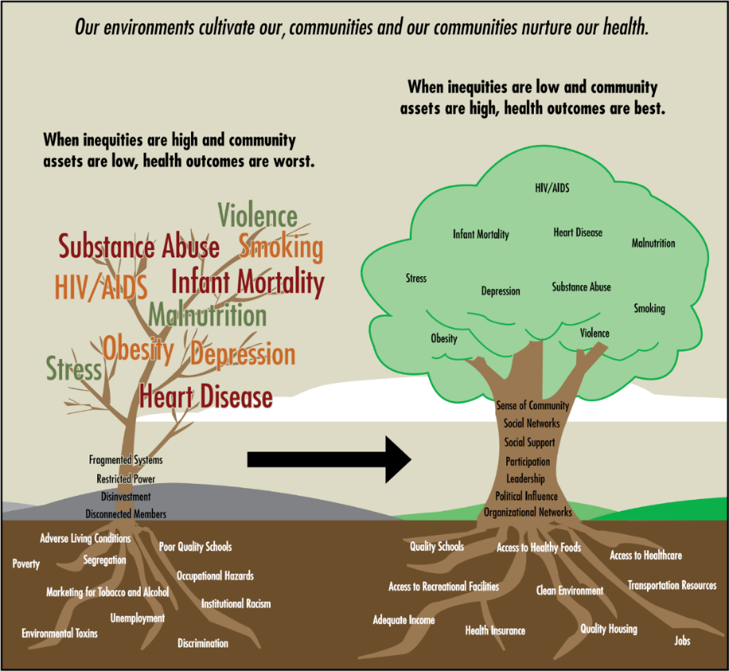
Figure adapted from Anderson et al., 2003; Marmoetal, 1999; and Wilkinson et al., 2003.^{39–41} From: Brennan Ramirez LK, Baker EA, Metzler M. Promoting Health Equity: A Resource to Help Communities Address Social Determinants of Health. Atlanta: U.S. Department of Health and Human Services, Centers for Disease Control and Prevention; 2008. (PDF under Social Determinants of Health)
Notes:
Here is a graphic example of the role of social determinants of health.
-The diseased tree on the left shows a community with a weak root system consisting of discrimination, institutional racism, unemployment, poverty, poor quality schools and other unhealthy social determinants of health, all of which lead to poor health, substance abuse and violence.
-The tree on the right depicts a community that has a strong root system, one that has quality housing and education, access to healthcare and jobs, adequate access to food and good nutrition, clean environment (no toxic spills/dumps), along with access to social supports, sense of community and participation, and political influence, all of which increase the health of the community and reduce disease and mental health conditions and lead to healthier lives and longer living. The incidence of poor outcomes (smaller print in the green leaves) is lessened as a result.
Discussion: What is it like in your community or your school’s community? Do you see both healthy and unhealthy social determinants of health that contribute to the health or lack of health in the community? Give some examples of what contributes positively and what contributes in a negative way.
-In our next slide we will discuss the school determinants of health and your role as educators in your community’s health.

Slide 9
Community Determinants of Health
A comprehensive approach to social determinants of health for community members requires identification of the determinants of health and well-being that are also culturally based.
These include:
Physical and structural environment
Health policies
Evidence-based health programs and resources
Workforce
Availability and access to services and supports to meet specific needs.
Can you think of others?
Notes:
• Studies across the world have found significant associations between community determinants and over-all health and well-being.
• Physical and structural environment examples that are associated with poor physical health, include: Inadequate activity space, little access to recreation facilities, high presence of tobacco smoke, radon, asbestos, mold, rodent infestation, and biological contaminants.
• Health policies that impact community determinants of health include: Policies that include high-quality health programs that integrate comprehensive and culturally competent sets of services, and practices that meet the health and safety needs of diverse community members can have positive impacts on health behaviors including the use of drugs and tobacco; they can also improve physical health, and overall functioning.
• Health programs and adequate workforce such as: having community health workers and other specialists including mental health specialists and services that are accessible and culturally as well as linguistically appropriate are associated with better physical and mental health outcomes.
• Community climate such as: opportunities for engagement with community members, community involvement, and building of social capital can also be effective.
Availability and access to services and supports to meet specific needs.

Slide 10
Group Discussion
What is it like in your community?
Do you see both healthy and unhealthy social determinants of health that contribute to the health or lack of health in the community?
Give some examples of what contributes positively and what contributes in a negative way.

Slide 11
Reflections
Write down two (2) actions you will take to address social determinants of health as it applies to your work.

Slide 12
Wrap-up and Summary
Post Survey – Handout 2

Slide 13
Thank you!

